Slide 1
Operating System (22CS005) Class
On
Mass Storage Structure
Department of Computer Science and Engineering,
Chitkara University, Punjab
Dr. Prabhjot Chahal

Slide 2
Index
Overview of Mass Storage Structure
Disk Structure
Disk Attachment
Disk Scheduling
Disk Management
Swap-Space Management

Slide 3
Overview of Mass Storage Structure
Magnetic disks provide bulk of secondary storage of modern computers
Drives rotate at 60 to 250 times per second
Transfer rate is rate at which data flow between drive and computer
Positioning time (random-access time) is time to move disk arm to desired cylinder (seek time) and time for desired sector to rotate under the disk head (rotational latency)
Head crash results from disk head making contact with the disk surface -- That’s bad
Disks can be removable
Drive attached to computer via I/O bus
Busses vary, including EIDE, ATA, SATA, USB, Fiber Channel, SCSI, SAS, Firewire
Host controller in computer uses bus to talk to disk controller built into drive or storage array

Slide 4
Moving-head Disk Mechanism

Slide 5
Disk Structure
Disk drives are addressed as large 1-dimensional arrays of logical blocks, where the logical block is the smallest unit of transfer.
The 1-dimensional array of logical blocks is mapped into the sectors of the disk sequentially.
Sector 0 is the first sector of the first track on the outermost cylinder.
Mapping proceeds in order through that track, then the rest of the tracks in that cylinder, and then through the rest of the cylinders from outermost to innermost

Slide 6
Disk Attachment
Host-attached storage accessed through I/O ports talking to I/O buses
SCSI (Small Computer System Interface) itself is a bus, up to 16 devices on one cable, SCSI initiator requests operation and SCSI targets perform tasks
Each target can have up to 8 logical units (disks attached to device controller)
FC (Fibre Channel) is high-speed serial architecture
Can be switched fabric with 24-bit address space – the basis of storage area networks (SANs) in which many hosts attach to many storage units
I/O directed to bus ID, device ID, logical unit (LUN)

Slide 7
Disk Scheduling
The operating system is responsible for using hardware efficiently — for the disk drives, this means having a fast access time and disk bandwidth
Minimize seek time
Seek time ≈ seek distance
Disk bandwidth is the total number of bytes transferred, divided by the total time between the first request for service and the completion of the last transfer

Slide 8
Disk Scheduling (Cont.)
There are many sources of disk I/O request
OS
System processes
Users processes
I/O request includes input or output mode, disk address, memory address, number of sectors to transfer
OS maintains queue of requests, per disk or device
Idle disk can immediately work on I/O request, busy disk means work must queue
Optimization algorithms only make sense when a queue exists

Slide 9
Note that drive controllers have small buffers and can manage a queue of I/O requests (of varying “depth”)
Several algorithms exist to schedule the servicing of disk I/O requests
The analysis is true for one or many platters
We illustrate scheduling algorithms with a request queue (0-199)
98, 183, 37, 122, 14, 124, 65, 67
Head pointer 53

Slide 10
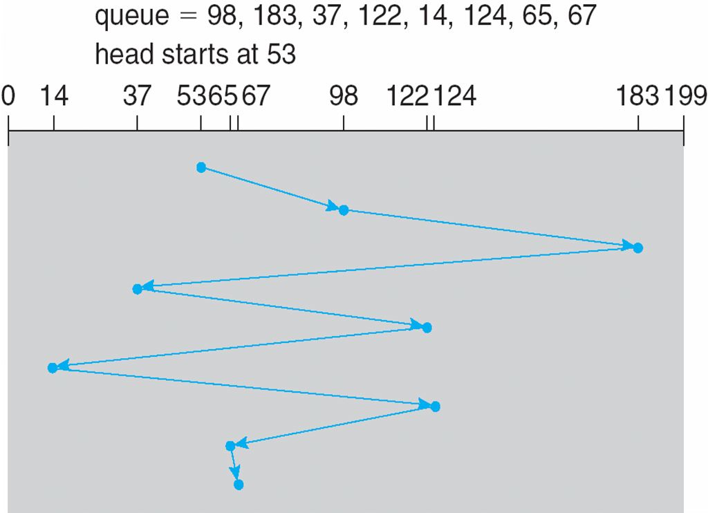
FCFS
Illustration shows total head movement of 640 cylinders

Slide 11
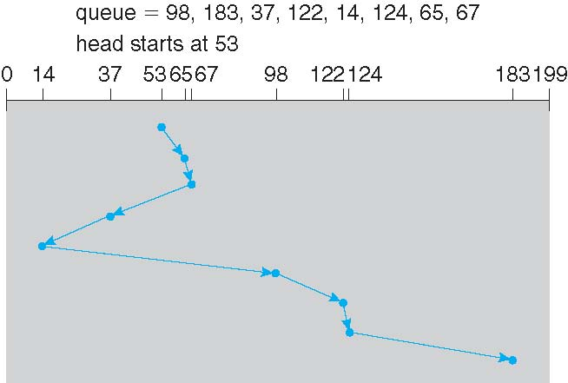
SSTF
Shortest Seek Time First selects the request with the minimum seek time from the current head position
SSTF scheduling is a form of SJF scheduling; may cause starvation of some requests
Illustration shows total head movement of 236 cylinders

Slide 12
SCAN
The disk arm starts at one end of the disk, and moves toward the other end, servicing requests until it gets to the other end of the disk, where the head movement is reversed and servicing continues.
SCAN algorithm Sometimes called the elevator algorithm
Illustration shows total head movement of 236 cylinders
But note that if requests are uniformly dense, largest density at other end of disk and those wait the longest

Slide 13
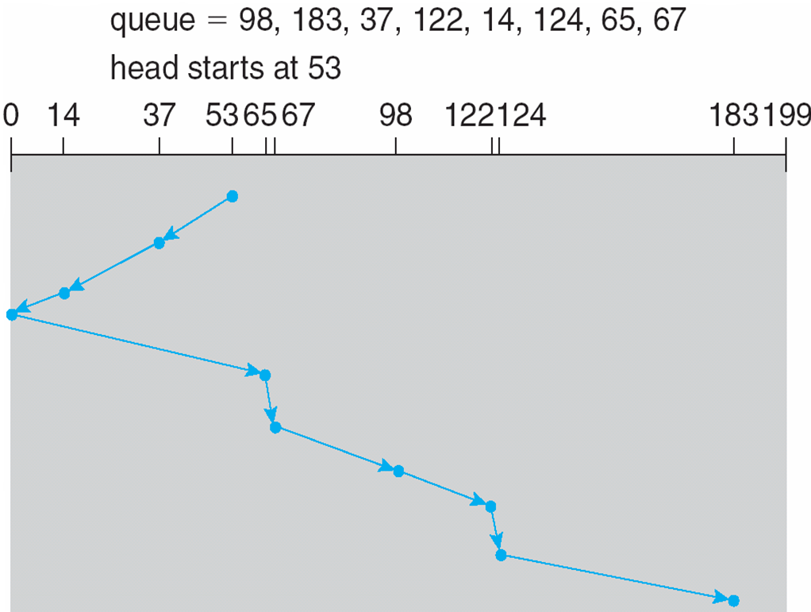
SCAN (Cont.)

Slide 14
C-SCAN
Provides a more uniform wait time than SCAN
The head moves from one end of the disk to the other, servicing requests as it goes
When it reaches the other end, however, it immediately returns to the beginning of the disk, without servicing any requests on the return trip
Treats the cylinders as a circular list that wraps around from the last cylinder to the first one
Total number of cylinders?

Slide 15
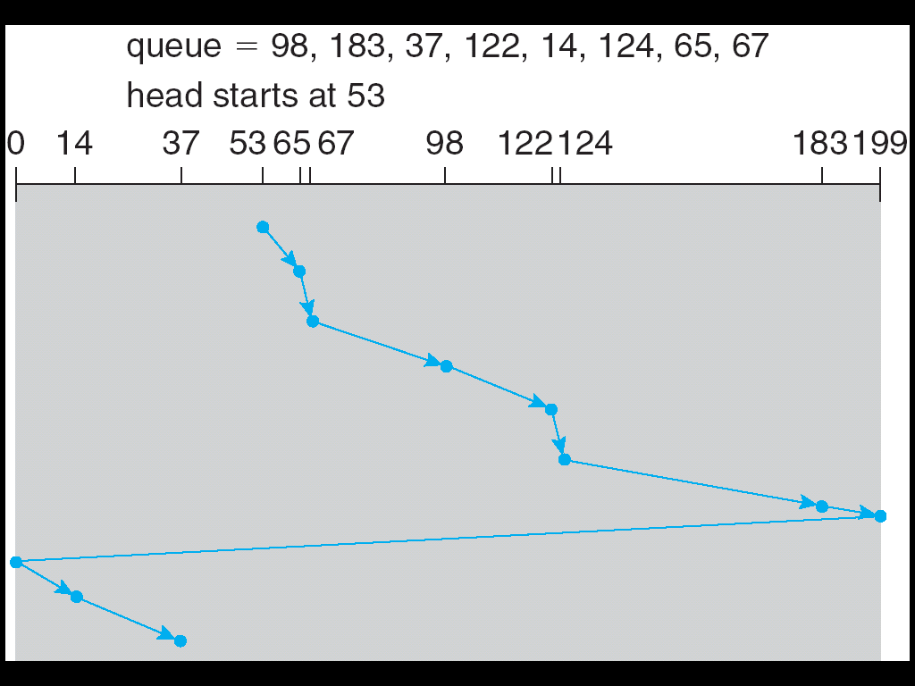
C-SCAN (Cont.)

Slide 16
C-LOOK
LOOK a version of SCAN, C-LOOK a version of C-SCAN
Arm only goes as far as the last request in each direction, then reverses direction immediately, without first going all the way to the end of the disk
Total number of cylinders?

Slide 17
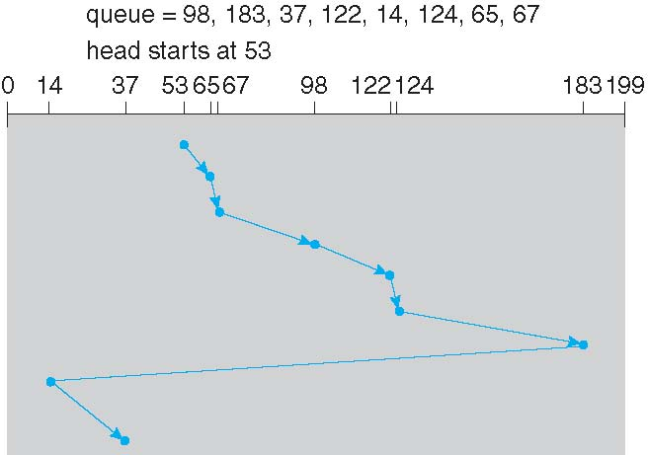
C-LOOK (Cont.)

Slide 18
Disk Management
Low-level formatting, or physical formatting — Dividing a disk into sectors that the disk controller can read and write
Each sector can hold header information, plus data, plus error correction code (ECC)
Usually 512 bytes of data but can be selectable
To use a disk to hold files, the operating system still needs to record its own data structures on the disk
Partition the disk into one or more groups of cylinders, each treated as a logical disk
Logical formatting or “making a file system”
To increase efficiency most file systems group blocks into clusters
Disk I/O done in blocks
File I/O done in clusters

Slide 19
Disk Management (Cont.)
Raw disk access for apps that want to do their own block management, keep OS out of the way (databases for example)
Boot block initializes system
The bootstrap is stored in ROM
Bootstrap loader program stored in boot blocks of boot partition
Methods such as sector sparing used to handle bad blocks

Slide 20
Swap-Space Management
Swap-space — Virtual memory uses disk space as an extension of main memory
Less common now due to memory capacity increases
Swap-space can be carved out of the normal file system, or, more commonly, it can be in a separate disk partition (raw)
Swap-space management
4.3BSD allocates swap space when process starts; holds text segment (the program) and data segment
Kernel uses swap maps to track swap-space use
Solaris 2 allocates swap space only when a dirty page is forced out of physical memory, not when the virtual memory page is first created
File data written to swap space until write to file system requested
Other dirty pages go to swap space due to no other home
Text segment pages thrown out and reread from the file system as needed
What if a system runs out of swap space?
Some systems allow multiple swap spaces

Slide 21
Data Structures for Swapping on Linux Systems

Slide 22
Thank You

